Slide 1
What Happened with Indiana Property Taxes in Pay-23—and Will it Happen Again?
Larry DeBoer
Professor of Agricultural Economics, Emeritus
Purdue University
November 30, 2023

Slide 2
How We Got Here: 1972-2023

Slide 3
The Bureau of Census American Community Survey estimates median homeowner property taxes for Indiana at $1,550, which is 8th lowest (44th highest) among the states and DC.
All of Indiana’s neighbors have higher property tax median payments.
Indiana’s median home value is $223,200, similar to our midwestern neighbors. The median state value is Wyoming’s, at $315,700.

Slide 4
As a percentage of state income, Indiana ranks 12th lowest (40th highest) among the states and DC.
The ranking changes because Indiana’s income is lower than the U.S. median, and Indiana’s business property taxes a somewhat higher than its homeowner taxes, relative to other states.

Slide 5
Indiana was not always a low property tax state.
50 years ago, Indiana had the 41st lowest (11th highest) property taxes as a percentage of income in the U.S.
Most states have reduced their property taxes relative to income, but Indiana has reduced them more than all but one other state (South Dakota).

Slide 6
Property taxes rose rapidly from 1951 to 1972. Otis Bowen’s tax package passed in 1973.
It reduced property taxes and slowed growth in three ways:
Limits on the size and growth of the levy
Replacing property taxes with sales taxes, moving tax collection from the local to state level
Creating local income taxes for tax relief and added local revenue.
Indiana continued to apply these methods for 50 years.

Slide 7
Property Tax Controls Reduce Tax Growth
Property taxes rose much faster than income from 1951-to 1972.
After property tax replacement credits reduced the tax level, maximum levy controls reduced tax growth.
Exceptions to controls accumulated during 1981-2007.
After replacing school general funds with sales taxes, Circuit Breaker caps and a tighter maximum levy formula reduced property tax growth.

Slide 8
Sales Taxes Rise to Reduce Property Taxes
The increase from 2% to 4% in 1974 funded property tax replacement credits.
The increase from 5% to 6% in 2002 funded homestead credits to reduce the effect of reassessment on homeowners.
The increase in from 6% to 7% 2008 allowed the elimination of the property tax for school general funds (now the education fund).
4 percentage points of our 7% sales tax originated with property tax relief.

Slide 9
Local Income Taxes rise to reduce Property Tax Growth
The first local income tax, CAGIT, was adopted by about 1/3 of Indiana counties in 1974. Most of these counties were rural. The revenue was used to mainly to reduce property taxes.
COIT was introduced in 1984 and adopted by most of the bigger urban counties. Revenue could be added to budgets.
Through the 1990’s more income tax options were introduced, more counties adopted, and many increased their rates.

Slide 10
Shift to State Taxation
Indiana has shifted tax revenue collection from local government to the state, mainly by raising sales taxes to reduce property taxes.
In1972, 51% of Indiana taxes were collected at the local level. By 2021only 27% of total taxes were local.
The percent of income paid to local taxes has decreased; the percent paid to state taxes has increased. Total state and local taxes have remained near 10% for the past 30 years.
In 2021 Indiana’s total state and local tax percent of income was 26th highest, which was the U.S. median value.

Slide 11
Property Tax Policy, 1972-2023
Fifty years ago, Indiana property taxes were among the highest in the nation. Now they are among the lowest.
Three policy approaches have achieved this reduction.
  State controls reduce the growth of property tax revenue. The maximum levy was established in 1974, and the circuit breaker caps in 2010.
  The state sales tax rate was increase in 1974, 2002 and 2008 to fund property tax relief. The local share of total taxes fell from 51% in 1972 to 27% in 2021.
  The state authorized local income taxes, which all counties have now adopted. Some LIT revenue provides direct property tax relief. Spendable LIT reduces overall reliance on the property tax
Despite the increases in sales taxes and LIT, overall state and local taxes remain near 10% of Indiana income, which is the median value for the United States.

Slide 12
What Happened in
Pay-23?

Slide 13
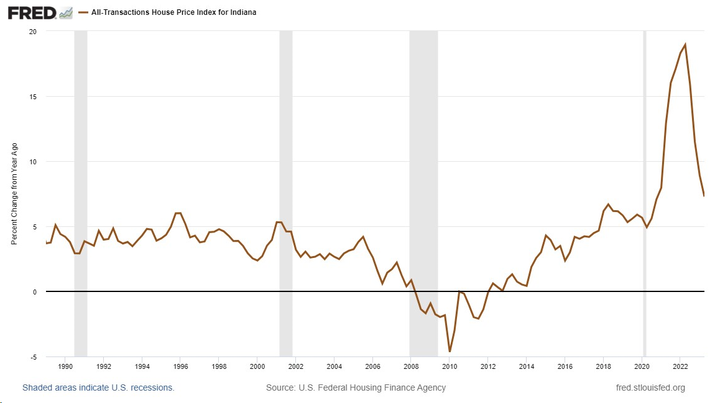
Indiana Home Price Index
(quarterly, all transactions)
Rising incomes, low interest rates and the slow recovery of home construction after the Great Recession began to increase home prices after 2013.
Rising demand and restricted supply began to raise home prices by mid-decade.
Home prices rose above 5% per year, 2018-2020.
The pandemic increased demand for space.
Prices accelerated after the pandemic. Peaking at 19% in 2022 Q2.

Slide 14
Indiana Farmland Values
(Dollars per acre)
Farmland values peaked in 2014, fell until 2017, then remained near $7,000 per acre through 2020.
Values increased rapidly in 2021 and 2022, reaching a record high over $10,000 per acre.
Rising corn and soybean prices are a primary reason for the land value increase.
Selling prices are not used to determine farmland assessments. But the factors that change selling prices affect the base rate calculation in the same way.

Slide 15
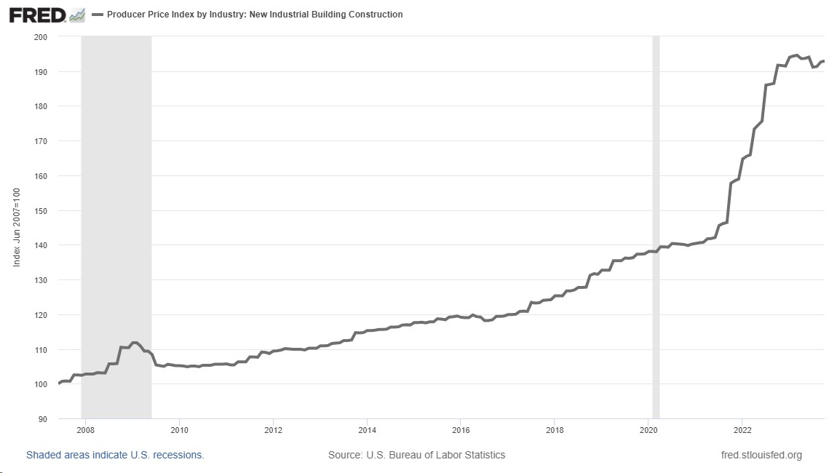
Industrial Building Construction Cost Index
Materials, equipment and labor costs for constructing industrial buildings accelerated starting in July 2021, mainly due to shortages of building materials.
The average annual inflation rate from 2010 through 2020 was 2.7%. Since then, it’s been 16.6%.

Slide 16
The Pandemic Economy and After
The effects of the pandemic and recovery on property values in 2020 and 2021 created the conditions for large assessed value increases in 2022-pay-2023.
Home values had been rising more rapidly than usual due to lagging construction, rising incomes and low mortgage rates. The pandemic saw even lower mortgage rates and an increased demand for space. Values rose rapidly.
Farmland values rose to historic highs after the pandemic, mainly due to rising corn and soybean prices.
Business building construction costs rose due to shortages of building materials.

Slide 17
Assessed value growth accelerated after 2017 as home prices began rising faster.
The pandemic increased the values of all real property in 2021, which led to the largest increase in gross assessed value in 20 years, for pay-2023.

Slide 18
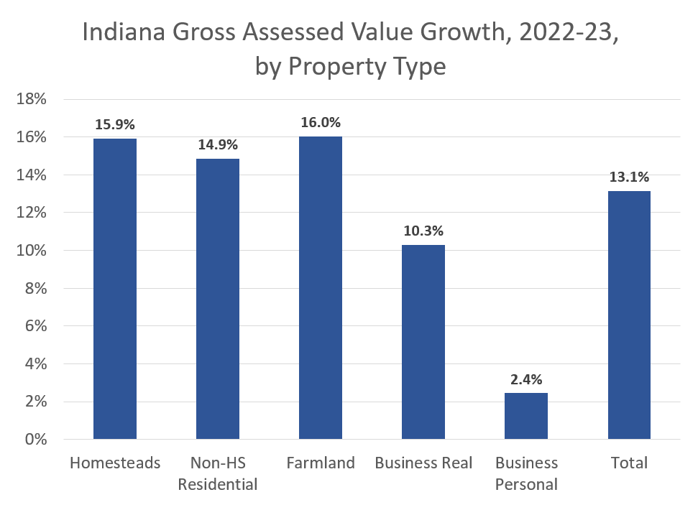
Real property assessments increased substantially in pay-2023. Business personal property (business equipment) increased much more slowly.

Slide 19
In total, net assessed value grew faster than gross assessed value.
This is almost entirely due to the more rapid increase in homestead net assessed value, which occurred because of the fixed standard homestead deduction ($48,000)

Slide 20
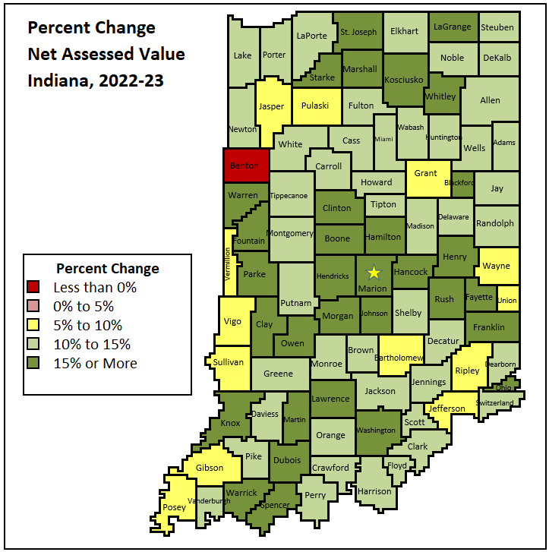
The large increase in net assessed value was a statewide event, with 91 counties rising above 5%.
77 counties saw double-digit increases, and 32 had NAV increases above 15%.
Benton County’s decrease was entirely due to a large drop in personal property.

Slide 21
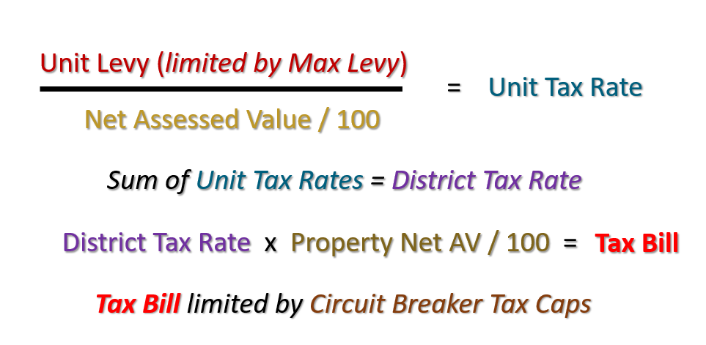
Indiana’s Property Tax: Assessments, Levies and Rates
Property Taxes, Pay-2023
Net Assessed Values rose a lot. Net Levies were limited by the maximum levy growth quotient.
Unit Tax Rates and District Tax Rates fell.
Taxpayers with net AV increases greater than tax rate decrease saw tax bill increases. Where net AV increases were smaller, tax bills fell.
Tax bill increases were not limited by circuit breaker caps, because caps are percentages of rising gross assessed value. Lower rates made fewer taxpayers eligible for tax cap credits.

Slide 22
The MLGQ is the average of Indiana non-farm income growth for six years, with a 2-year lag.
The MLGQ increased to 5% in 2023, because a high growth rate in 2021 replaced a lower growth rate in 2015 in the 6-year average.

Slide 23
Since 2019 actual levies have grown faster than the maximum levy growth quotient.
In 2023, levies grew much faster, 8.8% compared to the 5% MLGQ.

Slide 24
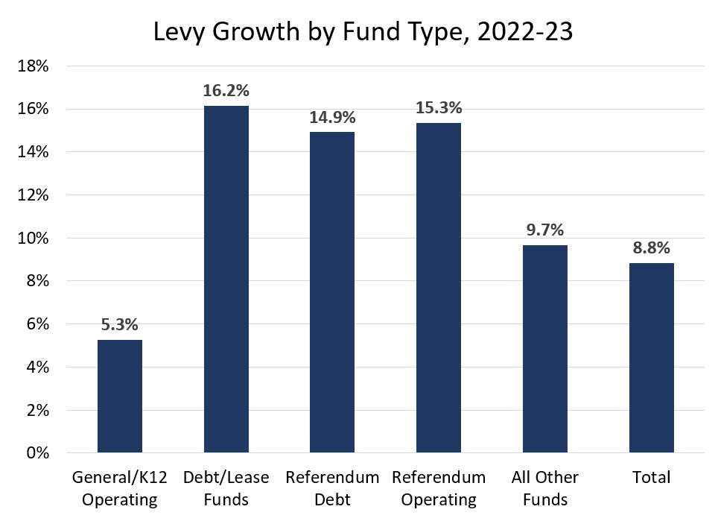
General funds and school operating funds are subject to the MLGQ. They grew only 5.3%.
Debt funds and referendum funds are outside the MLGQ. Growth in those funds accounted for the rapid growth of the total levy.

Slide 25
School corporations have most of the debt funds, and all the referendum funds. Rapid growth in school funds is the largest source of rapid levy growth.

Slide 26
Average Total Rate Change, 2022-23
 | 2022 | 2023 | Change | Pct. Change
County | 0.5564 | 0.5200 | -0.0363 | -6.5%
Township | 0.0931 | 0.0870 | -0.0061 | -6.6%
City/Town | 1.0290 | 0.9707 | -0.0583 | -5.7%
School Corp. | 1.1069 | 1.0585 | -0.0484 | -4.4%
Library | 0.1261 | 0.1167 | -0.0093 | -7.4%
Special Dist. | 0.1002 | 0.0995 | -0.0007 | -0.7%
Net AV rose 14.6%, and levies increased 8.8%. The average decline in tax rates was about 5.8%.
School and special district rate fell the least, library rates fell the most.

Slide 27
2023 was the first time since 2015 that circuit breaker tax cap credits did not increase.
Tax rates fell and gross assessed values increased. Tax bills did not rise as much as gross AVs, so fewer taxpayers were eligible for tax cap credits, and those who were eligible received less.

Slide 28
2023 was the first time since 2015 that circuit breaker tax cap credits did not increase.
Tax rates fell and gross assessed values increased. Tax bills did not rise as much as gross AVs, so fewer taxpayers were eligible for tax cap credits, and those who were eligible received less.

Slide 29
Levies increased by 8.8% while tax cap credits decreased slightly. The share of levies lost to credits saw the biggest drop since circuit breakers were established.

Slide 30
Since circuit breaker tax cap credits did not increase, all the added levy was collected by local governments.
The increase in the post-credit levy was 10.1%, greater than the 8.8% increase in the levy itself.

Slide 31
Big increases in net AV, smaller decreases in tax rates, and little change in tax cap credits produced substantial tax bill increases for all property owners except for personal property.

Slide 32
The Property Tax Shock of 2023
Real gross assessed values for pay 2023 increased substantially in response to the pandemic economy with large increases. Our assessment system does capture changes in property values.
Homestead net AVs rose even more, due to the fixed standard deduction.
Growth of levies under the maximum levy grew near the MLGQ rate of 5%.
Debt service and referendum levies grew much more, indicating that tax rates for these funds fell little, or were held constant.
Levies increased 8.8% in total, an unusually large increase.
Circuit breaker credits were almost unchanged, so post credit collections increased 10.1%.
Tax bills for all real property owners rose by unusually large amounts.

Slide 33
Will It Happen Again in Pay-2024?

Slide 34
Indiana Home Price Index
(Percent change from year ago, quarterly, all transactions)
The home value increase peaked at 19% in mid-2022 but was still 11% at the end of 2022.
Selling prices in 2022 are incorporated into gross assessed values in 2023 and taxed in pay-2024.

Slide 35
The DLGF has already calculated the base rate for pay-2024, at $1,900.
The base rate increase in 2023 was 16%. The rise from $1,500 to $1,900 in pay-2024 is 27%.

Slide 36
Industrial Building Construction Cost Index
Building construction inflation stopped after January 2023.
But that means prices were still 33% higher in December 2022 than in December 2021.

Slide 37
Certified net assessed values by tax district for 2024 were posted on Gateway in November.
Farmland net AVs are assumed to rise at the percentage increase in the base rate. Non-HS Residential is the remainder of the 2% category.
Total growth is lower, mainly due to slower growth in homestead and business real net assessments.
But 5.9% total growth is still a large increase compared to pre-2023 growth rates.

Slide 38
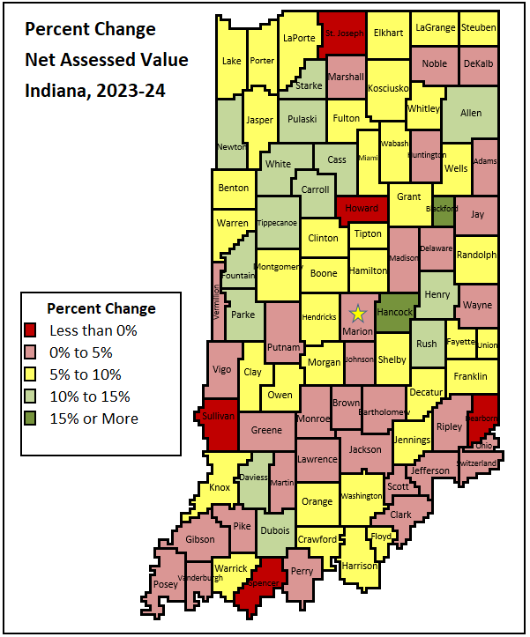
16 counties have total net assessed value increases above 10%. This is more than usual, but many fewer than the 77 counties with double-digit increases in 2023.
5 counties saw decreases in net AV, compared to only one in 2023.
Net AV in 33 counties grew between 0% and 5%, and in 38 counties, between 5% and 10%.
Rural counties saw 6.6% increase in net AV, compared to 5.0% in urban counties. The large rise in farmland assessments may be the reason.

Slide 39
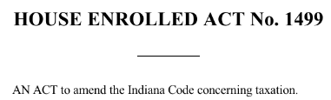
HB 1499 (2023)
Maximum Levy Growth Quotient. Limits the MLGQ for pay-2024 and 2025 to 80% of the usual calculation up to a 4% maximum. The MLGQ will be 4% in 2024, instead of near 5%. Assessed value growth will cause a bigger reduction in tax rates.
Homestead Supplemental Deduction. Raises the deduction from 35% for most homeowners to 40% in pay-2024 and 37.5% in pay-2025. This will reduce homeowner tax bills by shifting tax burden to other property owners. Property at the circuit breaker caps will not be affected.
School Operating Referendum Levy growth. Operating referendum growth is limited to 3% for pay-2024. Assessed value growth will require a reduction in referendum tax rates.

Slide 40
Effect of the Supplemental Deduction Increase
Suppose a home’s gross AV rises 10% from $220,000 to $242,000.
With the fixed standard deduction and a 35% supplemental deduction, net AV rises 12.8%.
The increase in the supplemental deduction to 40% reduces this increase to 4.1%.
The increase from 35 to 40 is 14.3%.
The reduction in net AV growth is between 8 and 10 percentage points for most home values and gross AV growth rates.
 | 35% Supplemental Deduction |  |  | 40% Supplemental Deduction
 | 2023 | 2024 | Pct Chg | 2024 | Pct Chg
Gross Assessed Value | 220,000 | 242,000 | 10.0% | 242,000 | 10.0%
Standard Deduction | 48,000 | 48,000 |  | 48,000
Remainder | 172,000 | 194,000 |  | 194,000
Supplemental Deduction | 60,200 | 67,900 |  | 77,600 | 28.9%
Net Assessed Value | 111,800 | 126,100 | 12.8% | 116,400 | 4.1%

Slide 41
Net AV, Levies and Rates in 2024: Some Guesswork
Suppose levies in funds under the maximum levy rise 4%, debt rates remain constant, so levies rise at the net AV increase of 5.9%, and operating referendum levies rise 3%.
Overall levies would increase about 4.5%.
With net AV rising 5.9%, average tax rates would fall about 1.4%.
Lower rates will make fewer taxpayers eligible for Circuit Breaker cap credits.
With the small net AV increases, 2024 homestead tax bills would rise by about 2%, before tax cap credits. Compare to an estimated 17% tax bill rise this year.
Business tax bill increases should be modest as well.
Non-homestead residential tax bill increases could be near 10%, while farmland tax bill increases could exceed 20%.

Slide 42
What Might Happen in Pay-2024?
Property value increases continued in 2022, which affected assessments in 2023 and will affect tax bills in 2024.
Certified net assessed values have increased 5.9% in total. Homestead and business increases are less. Net AV in the 2% category shows a bigger increase, with farmland likely to increase the most.
Levies will rise less in 2024 than in 2023, because of tighter state limits on levy growth, and slower growth in net AV.
The increase in the supplemental deduction from 35% to 40% probably cut homestead net AV growth by 8 to 10 percentage points, to 3.6%.
Average homeowner tax bill increases in 2024 likely will be modest, much less than in 2023.
Farmland tax bills are likely to increase substantially.

Slide 43
What Happened with Indiana Property Taxes in Pay-23—and Will it Happen Again?
Larry DeBoer
Professor of Agricultural Economics, Emeritus
Purdue University
November 30, 2023

